Slide 1

Machine Learning
Lecture 5 – KNN & Dimensionality Reduction

Slide 2
Overview
Instance-based Learning
K-Nearest Neighbors (KNN)
Distance Metrics
KD-Tree & Ball Tree Structures
Normalization
Dimensionality Reduction
Singular Value Decomposition (SVD)
Principal Component Analysis (PCA)
Linear Discriminant Analysis (LDA)
UMAP

Slide 3
Instance-based Learning
Instance-based learning algorithms make predictions by identifying similar samples inside the training set.
For each new (unseen) sample, the classifier/regressor searches the target output of similar samples. Then, it uses voting/averaging to output the prediction.
Advantages:
No training is required.
Easy to adapt/fit on new training samples, without requiring training.
Easy to implement.
Less sensitive to outliers.
Disadvantages:
Depend on the training set quality (e.g., the amount of noise)
Finding similar samples can be quite time-consuming in very large datasets.
Sensitive to irrelevant features.

Slide 4
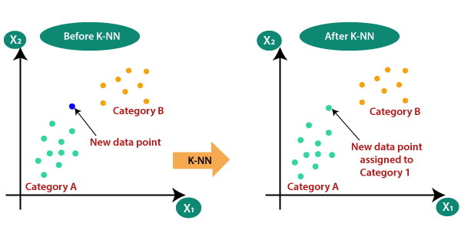

K-Nearest Neighbors (1)
It selects K most similar samples (nearest neighbors) using a distance metric.
Quite popular in database systems.
$$K=3$$
Training Set

Slide 5
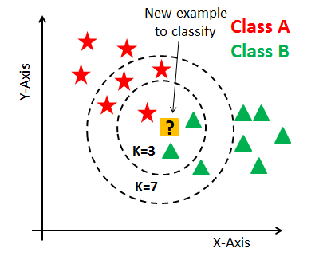
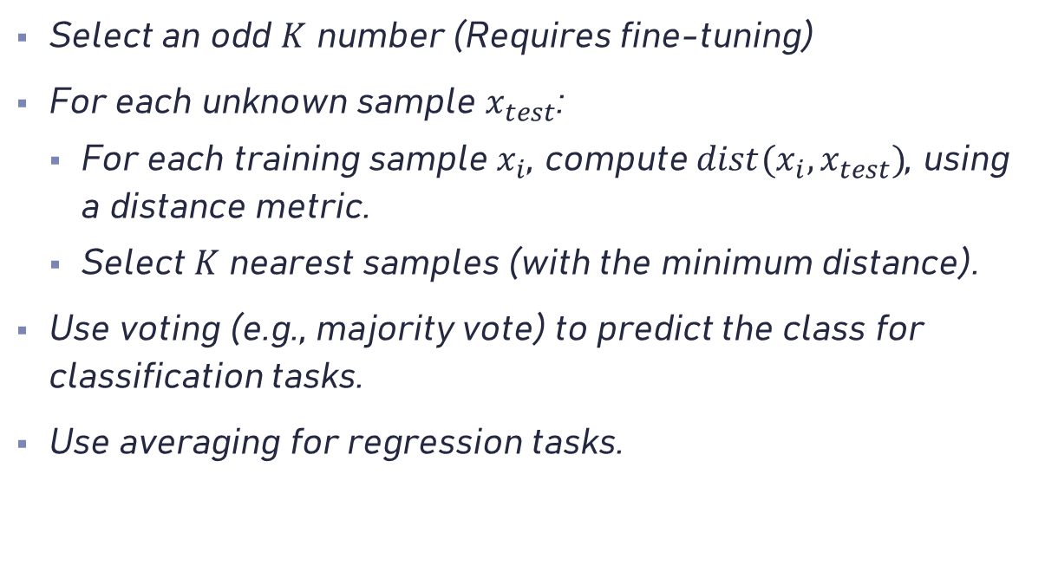
K-Nearest Neighbors (2)
Select an odd $K$ number (Requires fine-tuning)
For each unknown sample $x_{test}$:
For each training sample $x_{i}$, compute $dist(x_{i},x_{test})$, using a distance metric.
Select $K$ nearest samples (with the minimum distance).
Use voting (e.g., majority vote) to predict the class for classification tasks.
Use averaging for regression tasks.

Slide 6
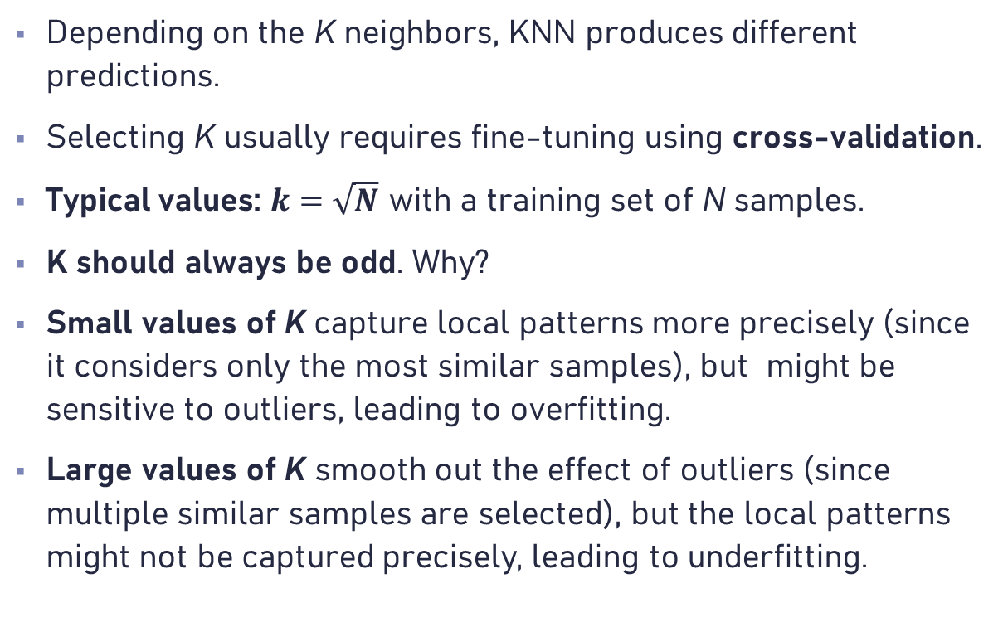
Selecting K Parameter
Depending on the K neighbors, KNN produces different predictions.
Selecting K usually requires fine-tuning using cross-validation.
Typical values: $k=\sqrt{N}$ with a training set of N samples.
K should always be odd. Why?
Small values of K capture local patterns more precisely (since it considers only the most similar samples), but might be sensitive to outliers, leading to overfitting.
Large values of K smooth out the effect of outliers (since multiple similar samples are selected), but the local patterns might not be captured precisely, leading to underfitting.

Slide 7
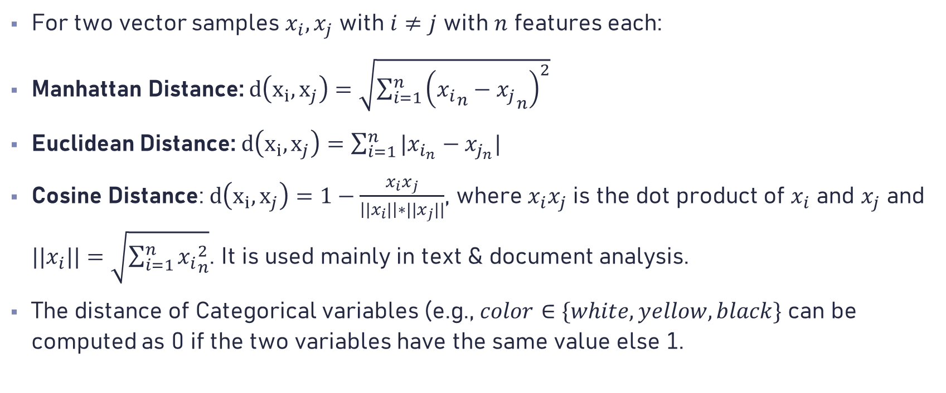
Distance Metrics
For two vector samples $x_{i}, x_{j}$ with $i≠j$ with $n$ features each:
Manhattan Distance: $d\left(x_{i},x_{j}\right)=\sqrt{\sum_{i=1}^{n}{{\left({x_{i}}_{n}−{x_{j}}_{n}\right)}^{2}}}$
Euclidean Distance: $d\left(x_{i},x_{j}\right)=\sum_{i=1}^{n}{|x_{i_{n}}−x_{j_{n}}| }$
Cosine Distance: $d\left(x_{i},x_{j}\right)=1−\frac{x_{i}x_{j}}{\left||x_{i}|\right|∗||x_{j}||}$, where $x_{i}x_{j}$ is the dot product of $x_{i}$ and $x_{j}$ and ${||x}_{i}||=\sqrt{\sum_{i=1}^{n}{{x_{i}}_{n}^{2}}}$. It is used mainly in text & document analysis.
The distance of Categorical variables (e.g., $color∈\{white, yellow,black\}$ can be computed as 0 if the two variables have the same value else 1.

Slide 8
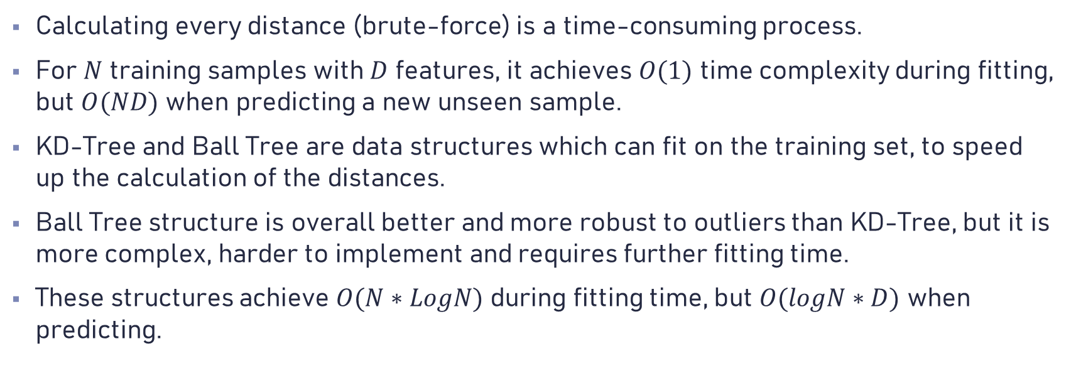
KD-Tree & Ball Tree Structures
Calculating every distance (brute-force) is a time-consuming process.
For $N$ training samples with $D$ features, it achieves $O(1)$ time complexity during fitting, but $O(ND)$ when predicting a new unseen sample.
KD-Tree and Ball Tree are data structures which can fit on the training set, to speed up the calculation of the distances.
Ball Tree structure is overall better and more robust to outliers than KD-Tree, but it is more complex, harder to implement and requires further fitting time.
These structures achieve $O(N∗LogN)$ during fitting time, but $O(logN∗D)$ when predicting.

Slide 9
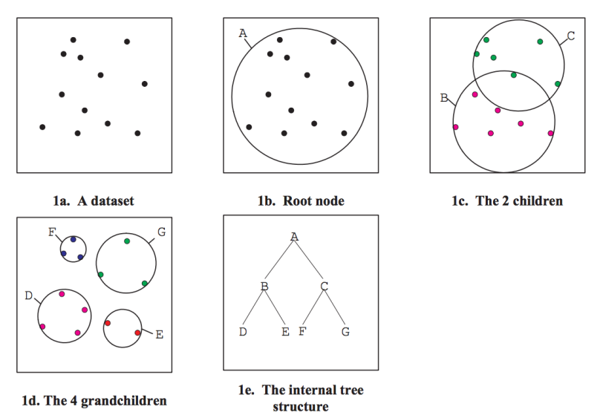
KD Tree Construction Demo

Slide 10
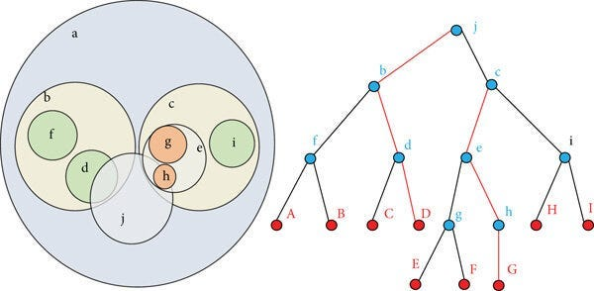
Ball Tree Construction Demo

Slide 11
Normalization
The performance of several algorithms (including Linear Regression, KNN, etc.) depends on:
The different scales between the variables (e.g., the value range affect the distance metric in KNN).
The distribution of the variables (e.g., linear regression assumes the variables follow normal distribution).
Normalization process tries to correct these issues and improve model performance. Common normalizers are:
MinMax
MaxAbs
Standard
Robust
Time Series Normalization

Slide 12
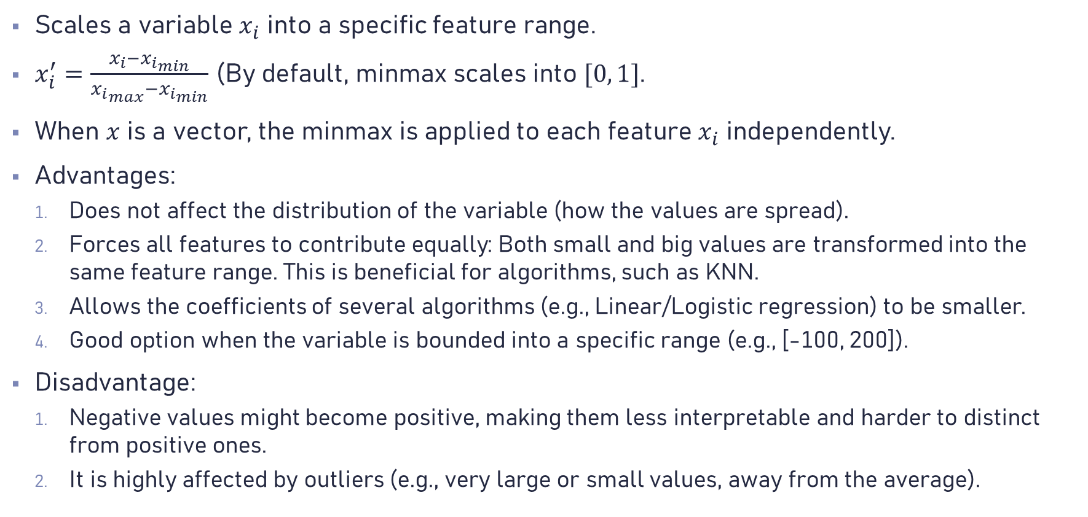
MinMax Scaler (1)
Scales a variable $x_{i}$ into a specific feature range.
$x_{i}^{′}=\frac{x_{i}−{x_{i}}_{min}}{{x_{i}}_{max}−{x_{i}}_{min}}$ (By default, minmax scales into $[0, 1]$.
When $x$ is a vector, the minmax is applied to each feature $x_{i}$ independently.
Advantages:
Does not affect the distribution of the variable (how the values are spread).
Forces all features to contribute equally: Both small and big values are transformed into the same feature range. This is beneficial for algorithms, such as KNN.
Allows the coefficients of several algorithms (e.g., Linear/Logistic regression) to be smaller.
Good option when the variable is bounded into a specific range (e.g., [-100, 200]).
Disadvantage:
Negative values might become positive, making them less interpretable and harder to distinct from positive ones.
It is highly affected by outliers (e.g., very large or small values, away from the average).

Slide 13
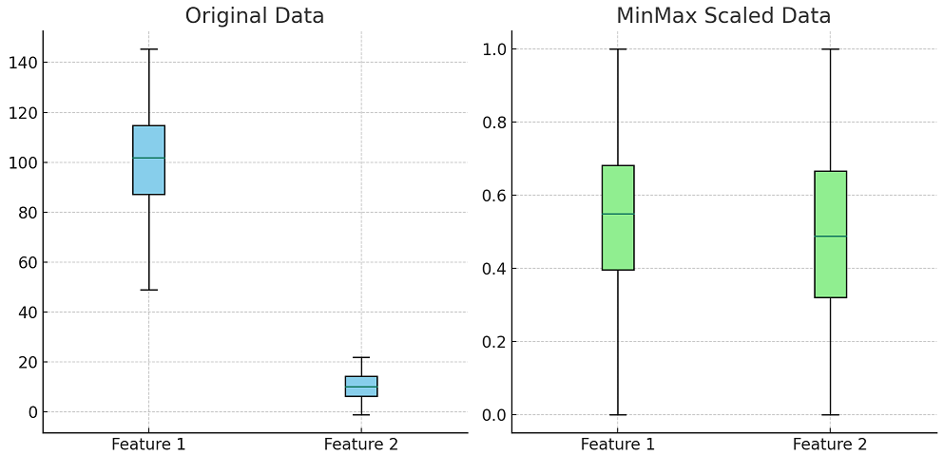
MinMax Scaler (2)

Slide 14
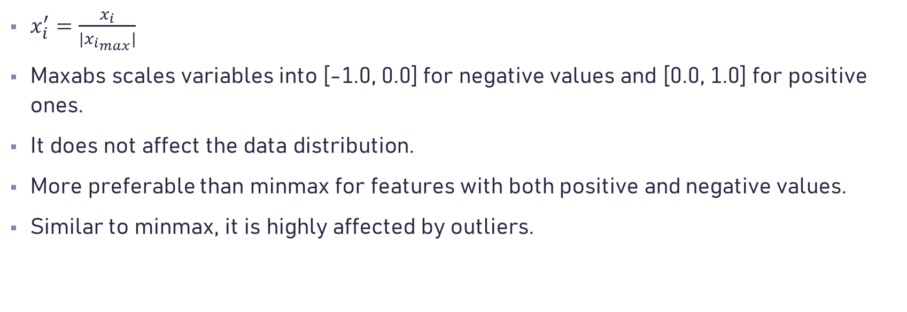
MaxAbs Scaler
$x_{i}^{′}=\frac{x_{i}}{|{x_{i}}_{max}|}$
Maxabs scales variables into [-1.0, 0.0] for negative values and [0.0, 1.0] for positive ones.
It does not affect the data distribution.
More preferable than minmax for features with both positive and negative values.
Similar to minmax, it is highly affected by outliers.

Slide 15
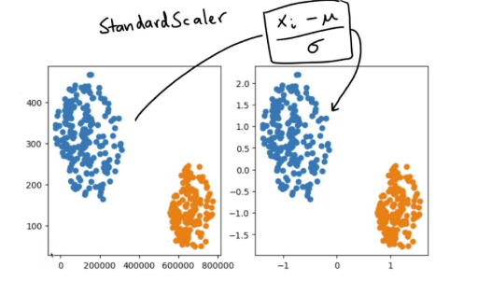
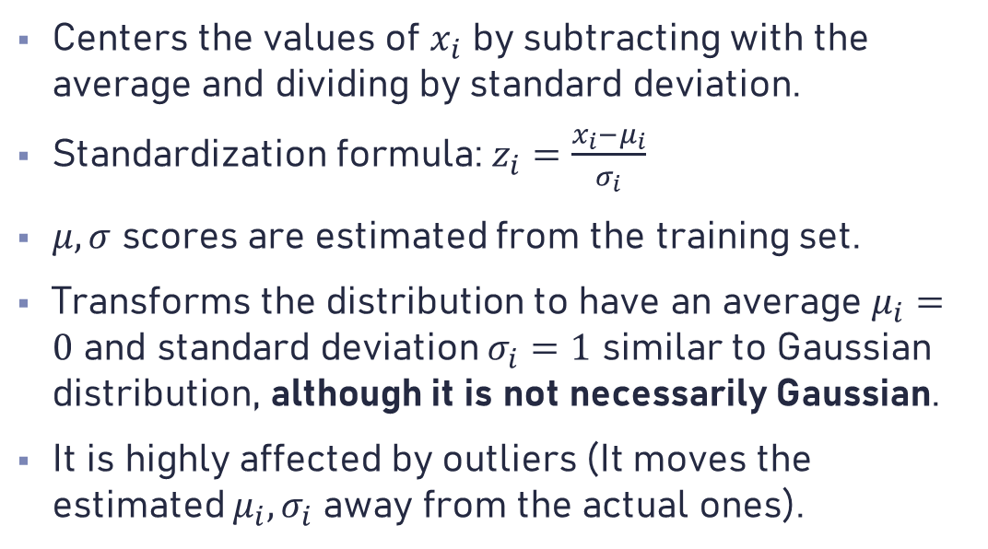
Standard Scaler
Centers the values of $x_{i}$ by subtracting with the average and dividing by standard deviation.
Standardization formula: $z_{i}=\frac{x_{i}−μ_{i}}{σ_{i}}$
$μ, σ$ scores are estimated from the training set.
Transforms the distribution to have an average $μ_{i}=0$ and standard deviation $σ_{i}=1$ similar to Gaussian distribution, although it is not necessarily Gaussian.
It is highly affected by outliers (It moves the estimated $μ_{i}, σ_{i}$ away from the actual ones).

Slide 16
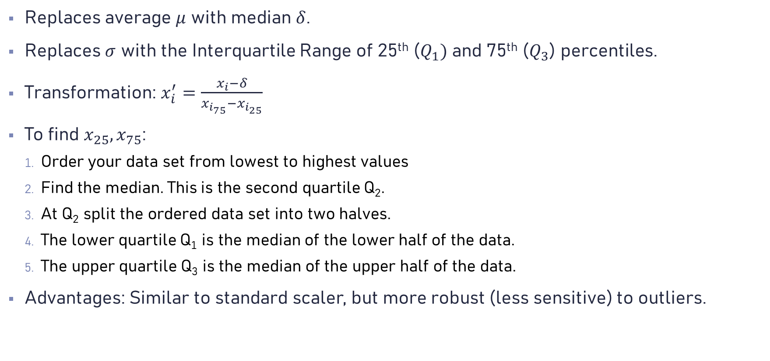
Robust Scaler
Replaces average $μ$ with median $δ$.
Replaces $σ$ with the Interquartile Range of 25th ($Q_{1})$ and 75th ($Q_{3}$) percentiles.
Transformation: $x_{i}^{′}=\frac{x_{i}−δ}{x_{i_{75}}−x_{i_{25}}}$
To find $x_{25},x_{75}$:
Order your data set from lowest to highest values
Find the median. This is the second quartile Q₂.
At Q₂ split the ordered data set into two halves.
The lower quartile Q₁ is the median of the lower half of the data.
The upper quartile Q₃ is the median of the upper half of the data.
Advantages: Similar to standard scaler, but more robust (less sensitive) to outliers.

Slide 17
Time Series Normalization
Minmax/Maxabs scalers can be used if the time series are bounded.
Standard/Robust scalers are typically a good option, if the time series is static: its average does not shift over the time (in different time periods).
Log returns is also a quite good option, especially in finance.
The best normalization technique does not exist. Fine-tuning is required.

Slide 18
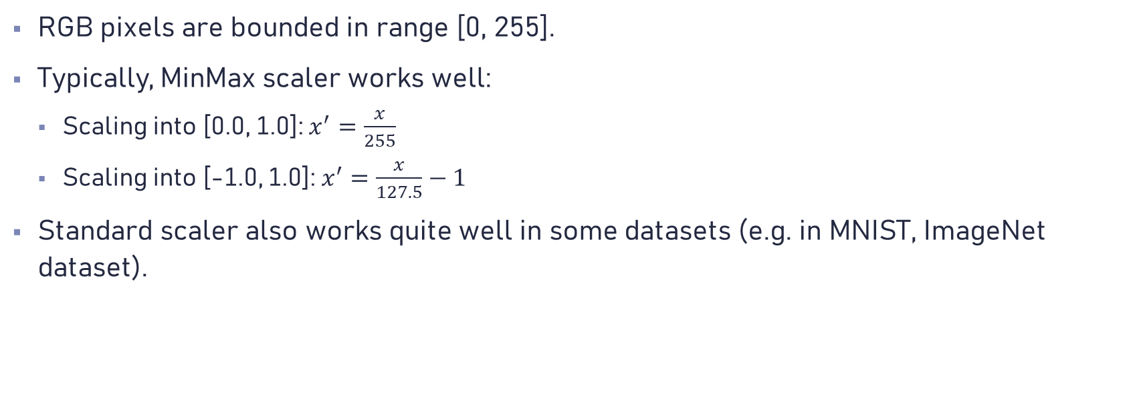
Image Normalization
RGB pixels are bounded in range [0, 255].
Typically, MinMax scaler works well:
Scaling into [0.0, 1.0]: $x^{′}=\frac{x}{255}$
Scaling into [-1.0, 1.0]: $x^{′}=\frac{x}{127.5}−1$
Standard scaler also works quite well in some datasets (e.g. in MNIST, ImageNet dataset).

Slide 19
Dimensionality Reduction (1)
A typical ML algorithm can easily fit on low-feature datasets (low dimensionality).
However, datasets with high dimensionality (e.g., images) can pose several challenges:
Increases model complexity, as it requires further parameters to be estimated for each feature.
Reduces model performance, as not all features are helpful and act as “noise” to the model.
Can cause a model to underfit or overfit, because it requires more complicated patterns to be discovered, which is difficult.
This problem is well-known as “curse of dimensionality”.

Slide 20
Dimensionality Reduction (2)
Correlation techniques (e.g., Pearson, Kendall, etc.) can be used to remove specific features that are correlated, but such methods do not provide information about the quality of a feature.
Typically, the quality of a feature is measured by its variance (spread). Low variance, means that a value is more-less the same and can be eliminated. However, this method might drop important information from the dataset.
Feature permutation techniques using brute-force can also be used, but they can be quite time-consuming.
Decomposition/Compression techniques:
SVD
PCA
LDA
UMAP

Slide 21
Singular Value Decomposition (SVD)

Slide 22
Principal Component Analysis (PCA)

Slide 23
Linear Discriminant Analysis (LDA)

Slide 24
UMAP

Slide 25
Machine Learning
Lecture 5 – KNN & Dimensionality Reduction

